Slide 1
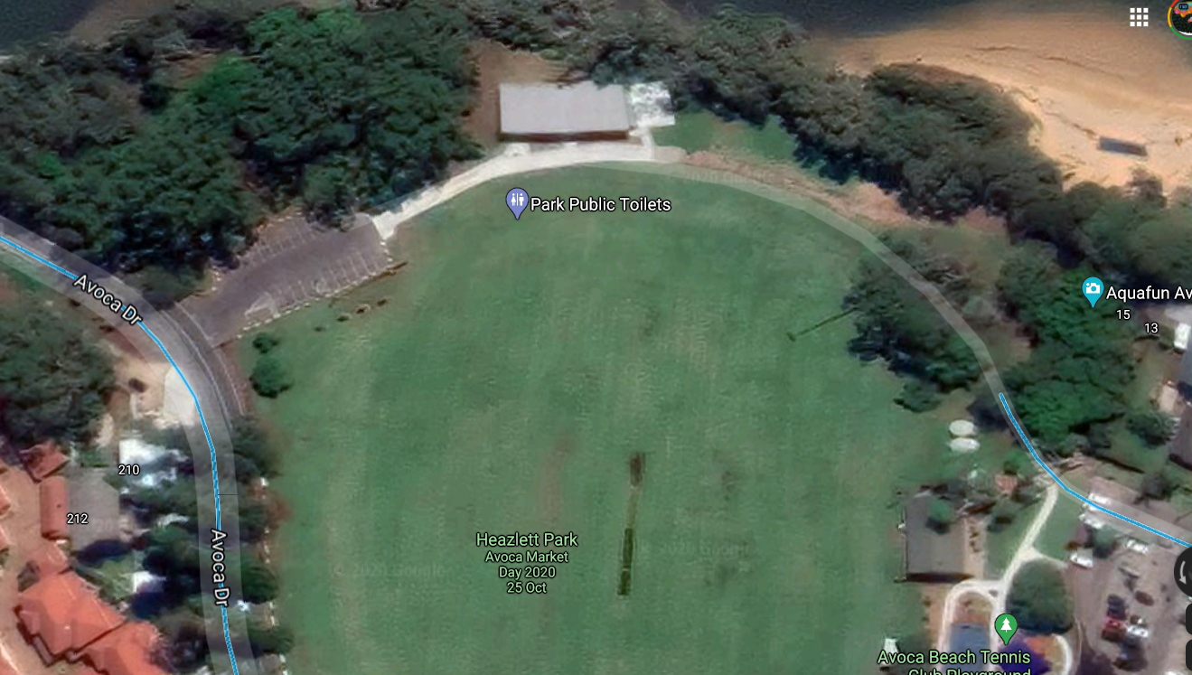
AVOCA BEACHSIDE MARKETS EVENT SITE PLAN 2021 - 2022
POWER
NO CAR ACCESS ONTO FIELD
Stalls must enter via Avoca Drive. It is one way. You MUST not exceed 5klm with hazards on. You must unpack quickly and exit. All stalls must have weights to be able to trade. Instant dismissal for stalls without weights. Gates will be locked at 8am strictly and not re-opened until it is clear of shoppers.

